Slide 1

Assignment 2 Task 2 Defend
Aryan Pareshbhai Patel – 12224021
Muskan Dharmendra Panchal – 12200237
Navdeep Singh Thakuri - 12216480

Slide 2
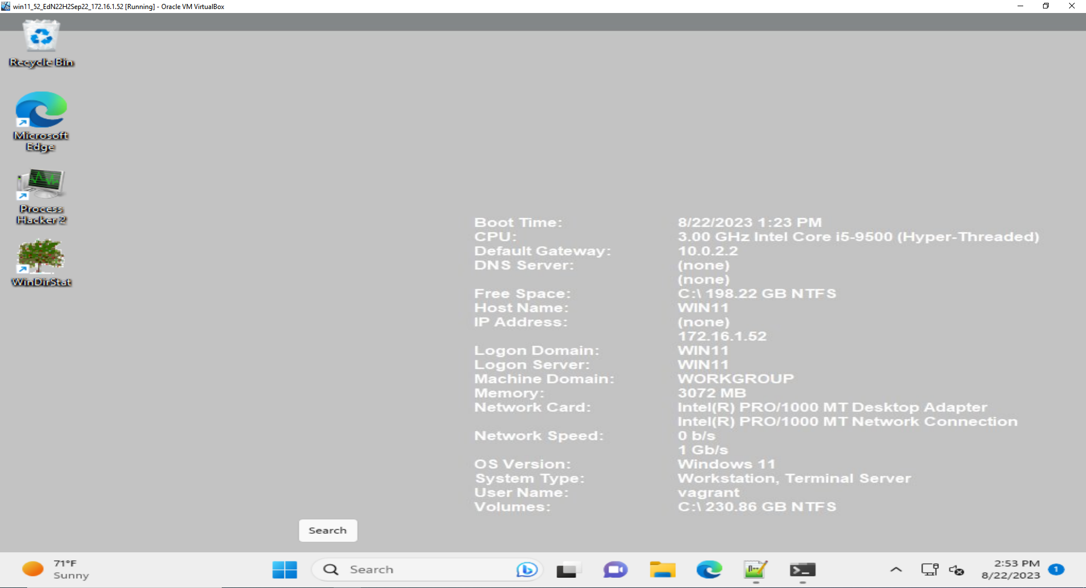
1. Windows 11 VM

Slide 3
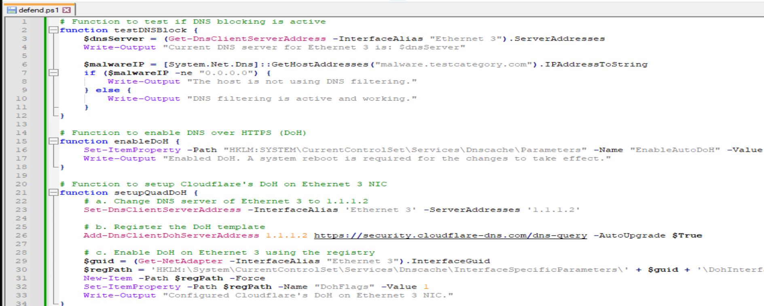
2. PowerShell script called defend.ps1

Slide 4
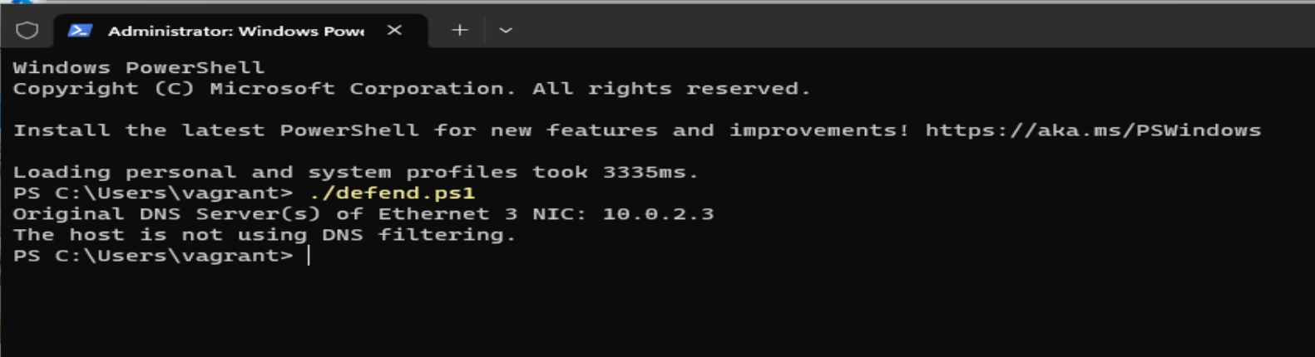
3. Pre-test: testDNSBlock
Tests DNS blocking and outputs DNS server of Ethernet 3.

Slide 5
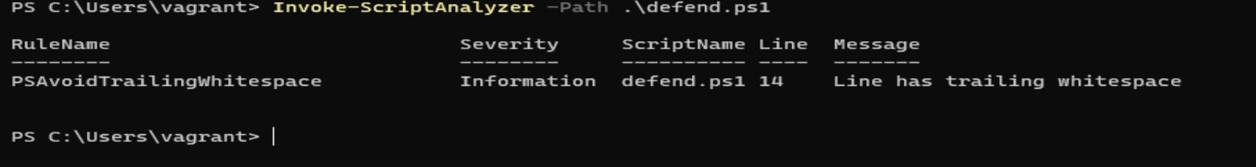
4. Use of PSScriptAnalzyer

Slide 6
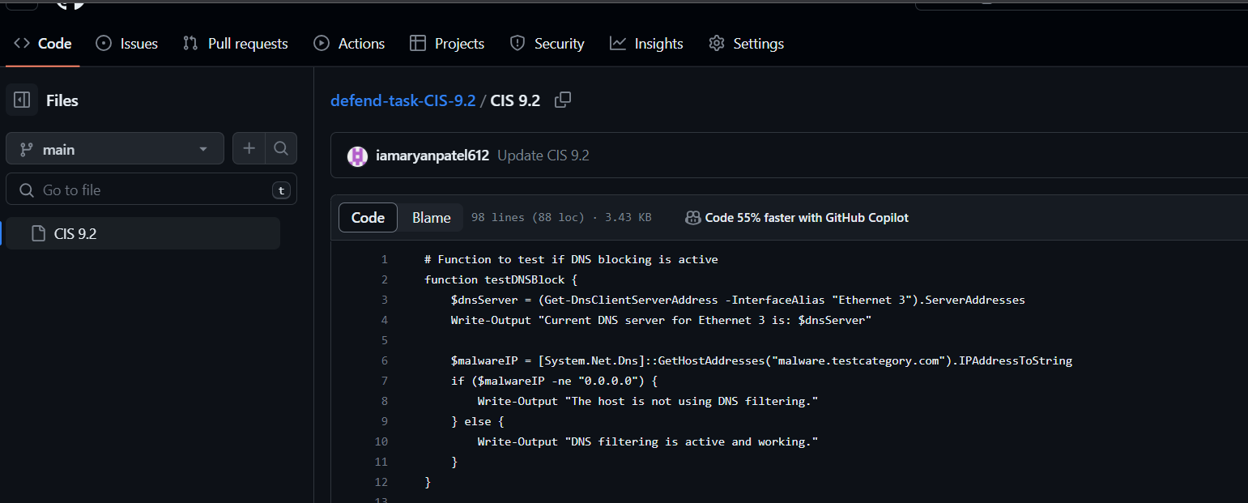
5. Github

Slide 7

6. Enable the DNS over HTTPS feature on Win11.
We added script for enableDoH() and ran the script.
Because of that script when we type the command enableDoH(), it got reboot.

Slide 8
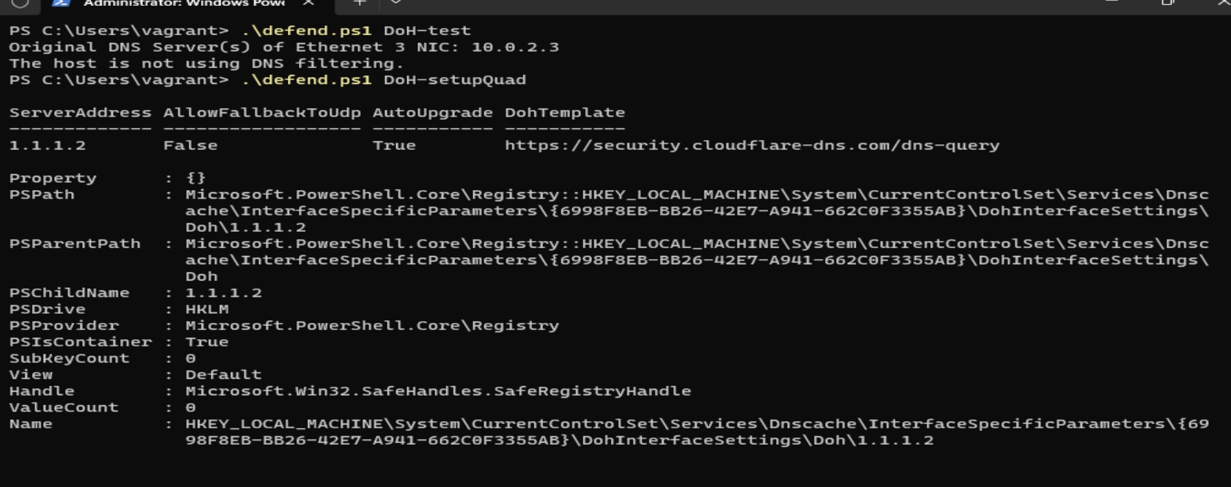
7. setupQuadDoH() function
Sets up Cloudflare's DoH on Ethernet 3 NIC.

Slide 9
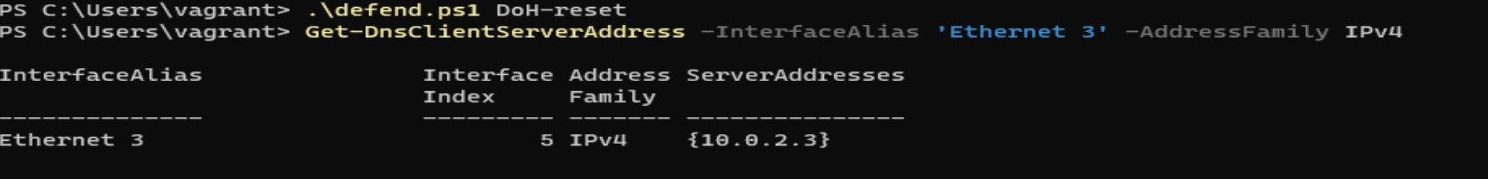
8. resetDoH
Resets DoH settings to their defaults.

Slide 10
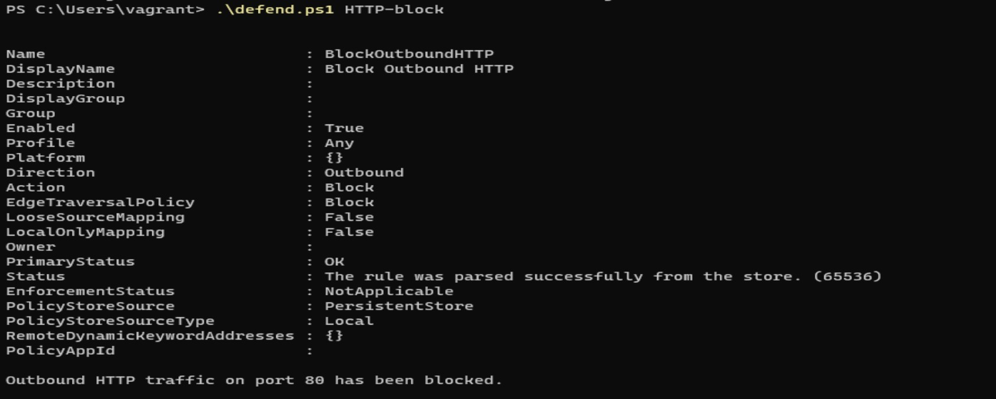
9. blockHTTP
Configures firewall to block HTTP traffic on port 80.

Slide 11
10. testHTTPBlock
Tests if HTTP traffic on port 80 is blocked.
As we can see HTTP traffic port 80 is blocked.

Slide 12
11. disableHTTPBlock
Disables the firewall block for HTTP traffic on port 80.
After giving the unblock script, we can see HTTP traffic on port 80 has been unblocked.

Slide 13
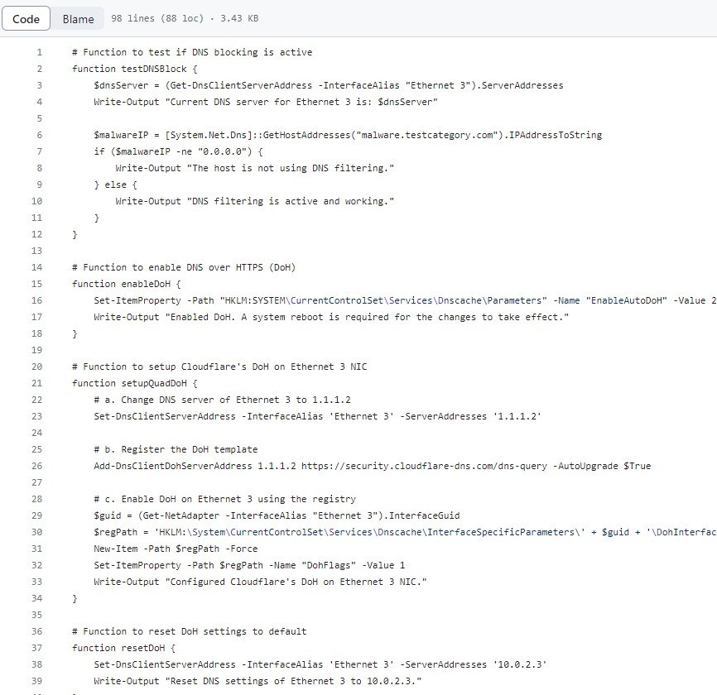
GitHub Link
https://github.com/iamaryanpatel612/defend-task-CIS-9.2.git

